Slide 1

Physics 1425 General Physics 1 Static Equilibrium: Elasticity and Fracture
E. Craig Dukes

Slide 2
Translational Equilibrium

Slide 3
Translational Equilibrium
When a body is at rest we say it is in a state of static equilibrium.
Examples:
Average 1425 student
Plant hanging from the ceiling
Building
When a body is moving with a constant velocity we say it is in a state of dynamic equilibrium.
Examples:
Car moving on a highway
Skydiver
In both cases the sum of the forces on the object is zero and we say it is in translational equilibrium.

Slide 4
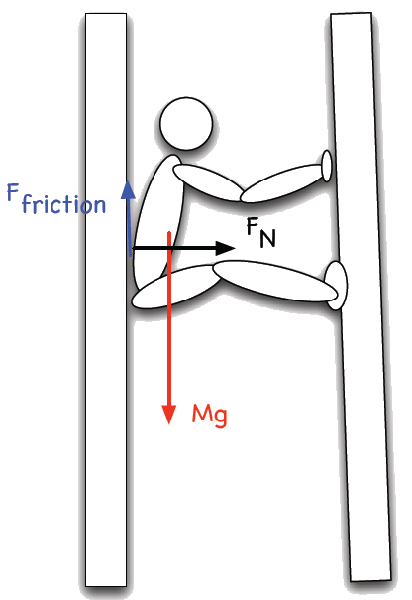
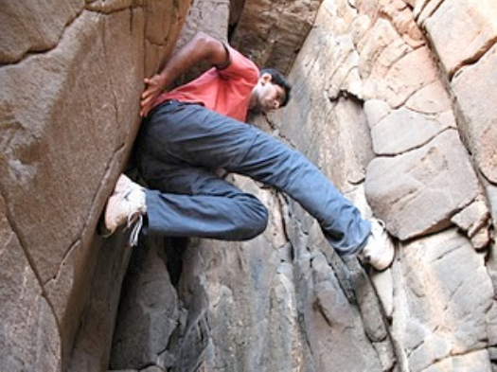
Static Equilibrium
Climber pushes against the walls to increase the normal force which increases the friction force (opposite to the gravitational force).
Remember:

Slide 5
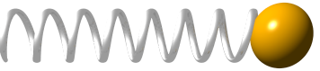
Translational Equilibrium
Now, the clever physics 1425 student might ask:
“Doesn’t Newton’s Third Law imply that all objects are in a state of translational equilibrium? After all:
No! If F_{AB} is the force the spring exerts on the ball then F_{BA} is the force the ball exerts back on the spring. We are not allowed to add them together because they act on different objects.

Slide 6
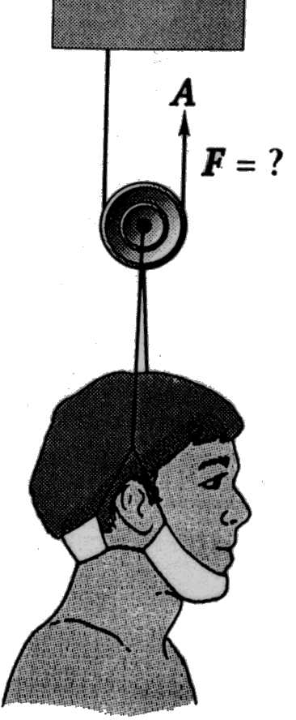
Example: Traction Apparatus
What force must be exerted at A to give an upward force of 32 N on the cervical traction device.
Draw a diagram with all the forces:
Since a = 0 we have ΣF = 0: Translational Equilibrium.
Note that T₁ = T₂ or else the pulley would rotate.

Slide 7
Example: Plant Holder
A plant is hung from two wires as shown below. What is the tension in the wires?
Draw a diagram showing all of the forces and the coordinate system. Note that you don’t really have to draw all the forces, just the important ones.
Note that the sum of the forces acting on any given point is zero because we have static equilibrium.
P
y
x
What forces have I left out?
Note that T₁ does not have to equal T₂ as would be the case if we had a pulley at P.

Slide 8
Example: Plant Holder
y
Draw the forces acting on P:
Apply Newton’s 2nd law:
Solve for T₁ using the first equation:
Plug this into the second equation and solve for T₂:
x
y
x
Greater than mg!

Slide 9
Example: Plant Holder
y
x
Plug in numbers for T₁:
Note that:

Slide 10
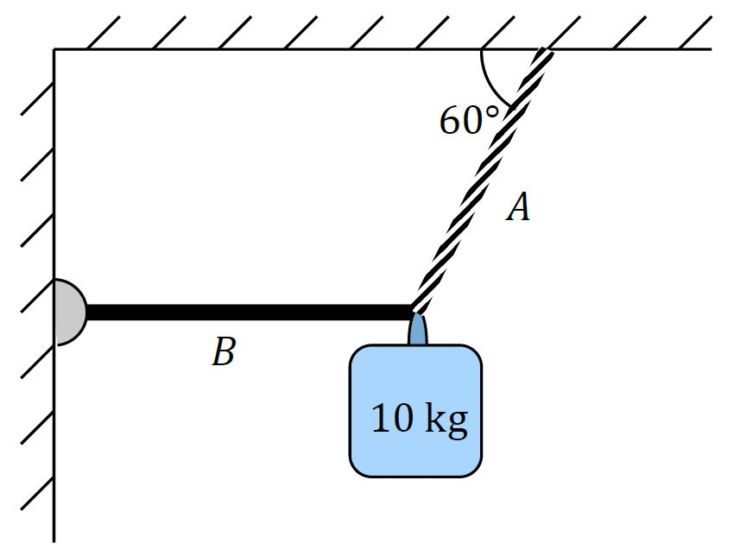
iClicker Question
A mass of 10 kg is suspended from a cable A and a light, rigid, horizontal bar B that is free to rotate, as shown. What is the approximate tension in cable A?
58 N
173 N
141 N
346 N
115 N

Slide 11
Static Equilibrium (revisited)
We learned several chapters ago that if a body is motionless then:
We implicitly assumed that all the forces were acting on the center of mass.
There is an exception to this rule: it might rotate with every increasing angular acceleration, even though the net force action on it is zero.

Slide 12
Rotational Equilibrium
The sum of the torques is zero:
Static Equilibrium: no translational or rotational motion
Dynamic Equilibrium: no translational or rotational acceleration
A rigid body is in equilibrium if the translational and rotational accelerations are both zero. Hence:

Slide 13
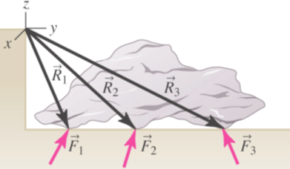
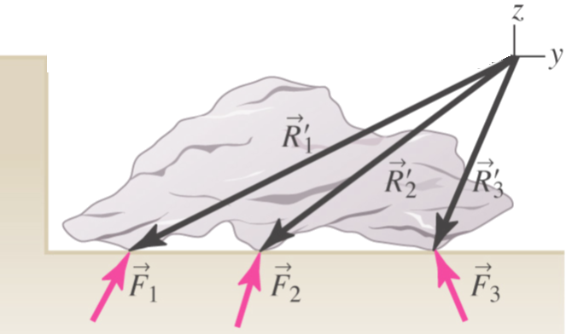
Note on Coordinate System
When in static equilibrium the torque is zero, and zero about any point you may choose. So choose a convenient point!
The easy way to find the sign of the torque is to assume the body is free to rotate and that the force in question is the only one acting on it.

Slide 14
Example: Sign
A sign weighing 400 N is suspended at the end of a uniform rod 4-m long weighing 500 N and joined to the wall with a hinge.
Note: you can choose any pivot point you want in static equilibrium problems! Choose a convenient one!
pivot
point
force wall exerts on rod
Beer
a) What is the tension in the support cable?
Only 3 torques around pivot point

Slide 15
Example: Sign
b) What is the force the hinge exerts on the rod?
Beer
Substitute this into Eq. 2:
divide both sides by –F_{T}cosθ:
The force is pointed up, not down!
Substitute this angle back into Eq. 1 to find F:

Slide 16
Problem Solving Techniques for Statics
Draw extended free-body diagram of object in question, showing all forces and where they act
Choose origin and coordinate system to make torque calculation as easy as possible
Choose a direction for positive torque
Write down statics conditions – vector sum of forces is zero, as is vector sum of torques
Count equations to make sure there are as many equations as unknowns
Solve algebraically – don’t plug in numbers until you have a solution

Slide 17
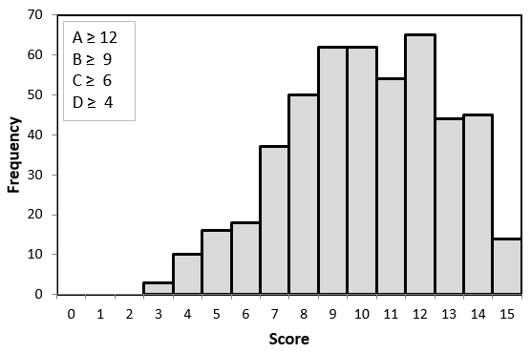
Midterm 2 Distribution

Slide 18
Example: Ladder
A ladder of unknown mass and length l is placed against a wall covered in ice. What is the minimum coefficient of friction between the ladder and the ground needed to keep the ladder from sliding down?
pivot
point

Slide 19
The Lever
“Give me a place to stand and I will move the earth.”
Archimedes
We have a case of static, or perhaps dynamic equilibrium:
use pivot as pivot point, θ = 90°

Slide 20
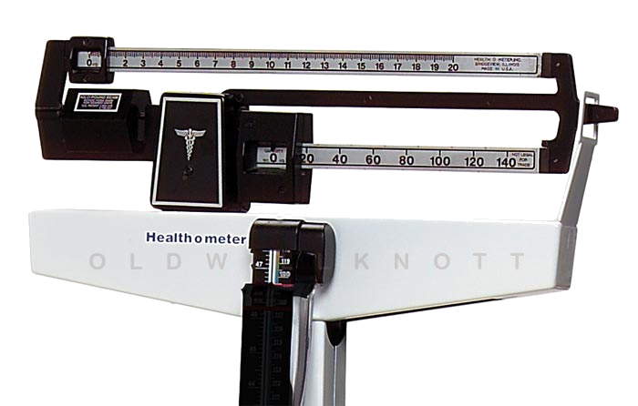
The Lever

Slide 21
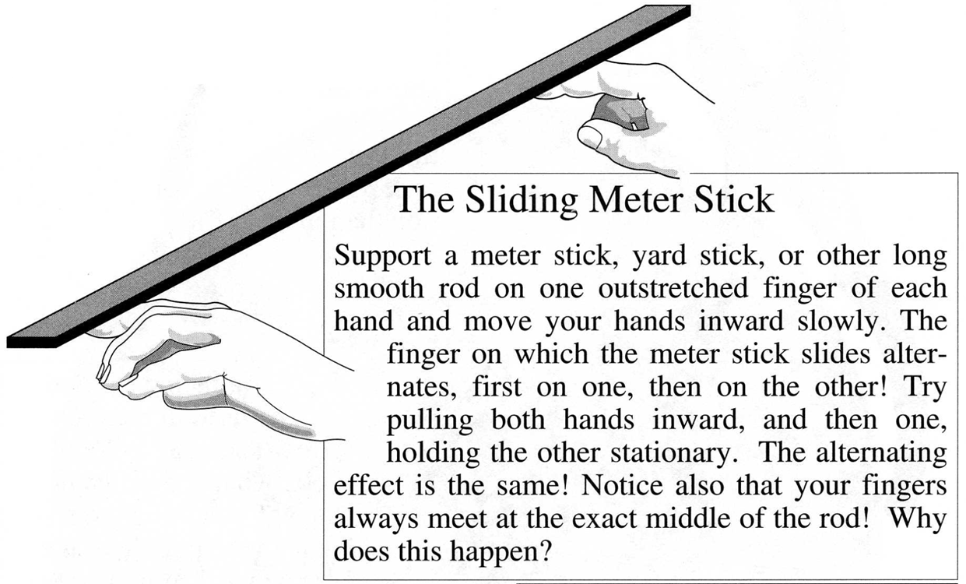
Home Demonstration: Sliding Meter Stick

Slide 22
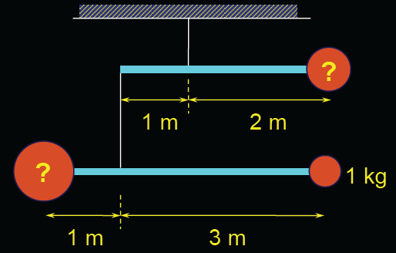
iClicker Question
A (static) mobile hangs as shown below. The rods are massless and have lengths as indicated. The mass of the ball at the bottom right is 1 kg. What is the total mass of the mobile?
5 kg
6 kg
7 kg
8 kg
9 kg
Use torques in two steps: (1) find the big mass on the bottom left (lower rod only), and (2) use the entire lower rod assembly (with two masses) to find the mass on top right. Finally, add up all the masses.

Slide 23
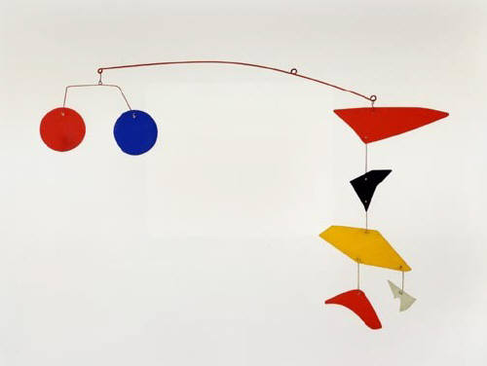
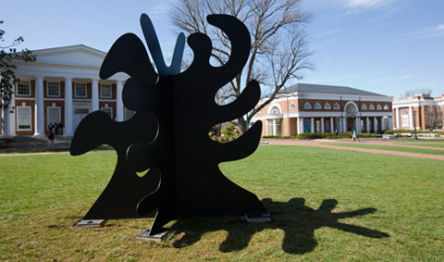
Alexander Calder

Slide 24
Stability and Balance
A body in static equilibrium will stay so forever, unless the object is displaced slightly, in which case three possible outcomes occur:
The object returns to its original position; in which case it is said to be in stable equilibrium.
The object moves even further from it original position; in which case it is said to be in unstable equilibrium.
The object remains in its new position; in which case it is said to be in neutral equilibrium.
Stable equilibrium
Unstable equilibrium
Neutral equilibrium

Slide 25
Stability and Balance
counterclockwise torque
clockwise torque
A body whose center of mass is above its base of support will be stable if a vertical line projected downward from the center of mass falls within the base of support.

Slide 26
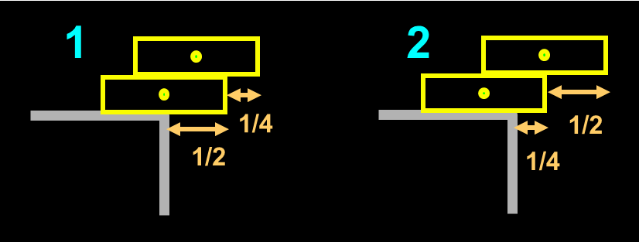
iClicker Question
Consider the two configurations of books shown below. Which of the following is true?
Case 1 will tip
Case 2 will tip
Both will tip
Neither will tip
The CM is midway between the CM of each book. Therefore, the CM of case #1 is not over the table, so it will tip.

Slide 27
Solids and How they Respond to Forces

Slide 28
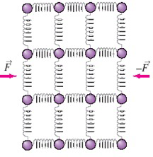
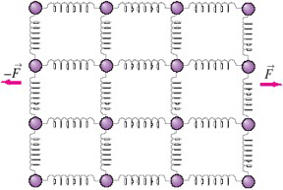
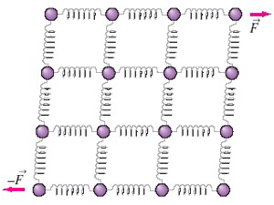
Solids Responding to Forces
Compression
Tension (stretching)
Response is due to the interatomic forces – interatomic bonds.
It is the nature of these bonds that differentiate steel from pie crust, diamond from graphite!
Shear

Slide 29
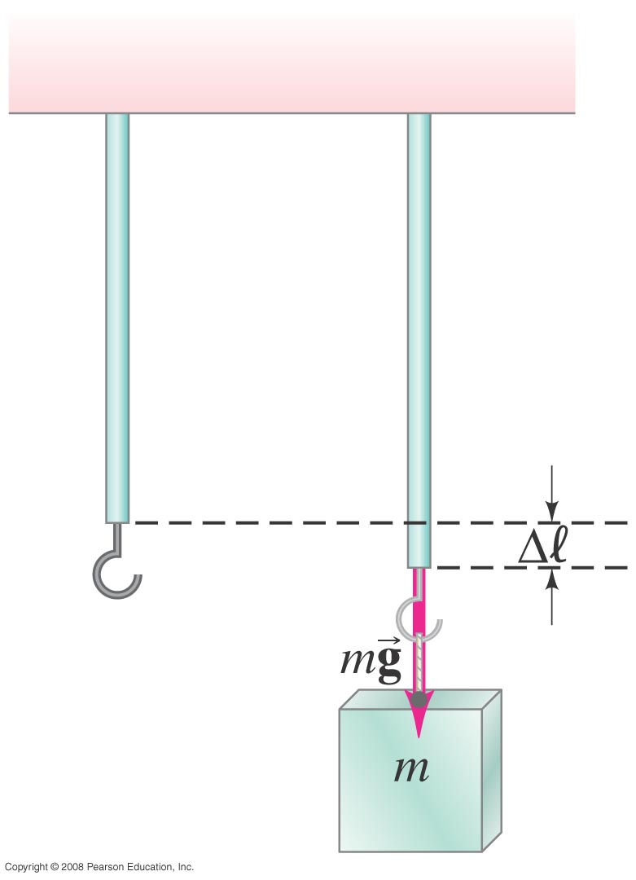
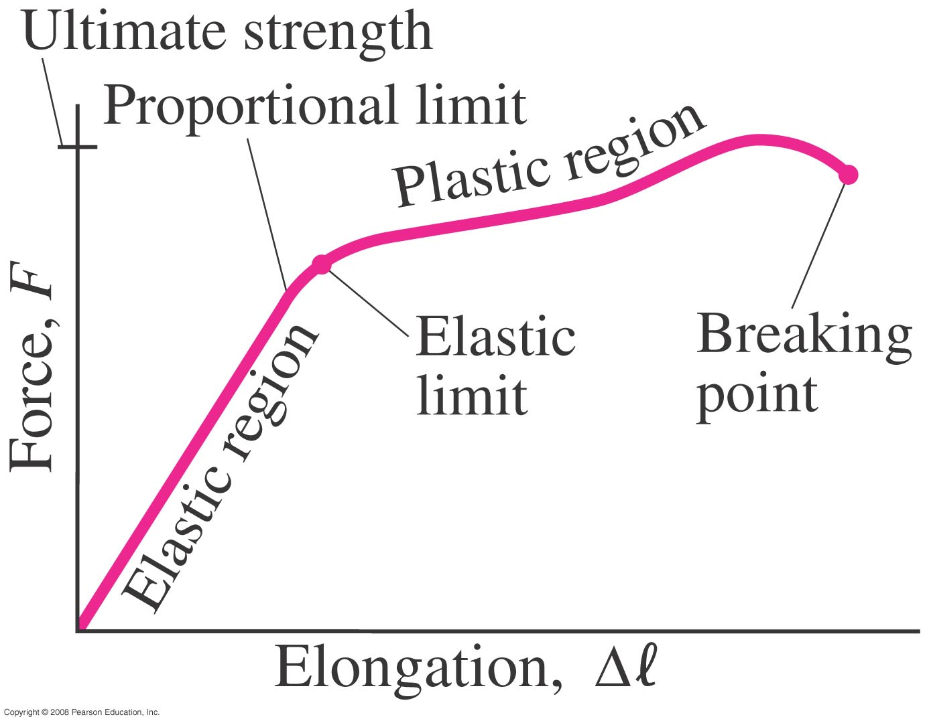
Stress and Strain
Hooke’s Law:

Slide 30
Stress and Strain
The fractional change in length is proportional to the force per area
E is the elastic, or Young’s modulus. It is equal to the amount of force/area need to produce a fractional change in length. I like to write it as:
The bigger E is, the more force you need to change the length of something.

Slide 31
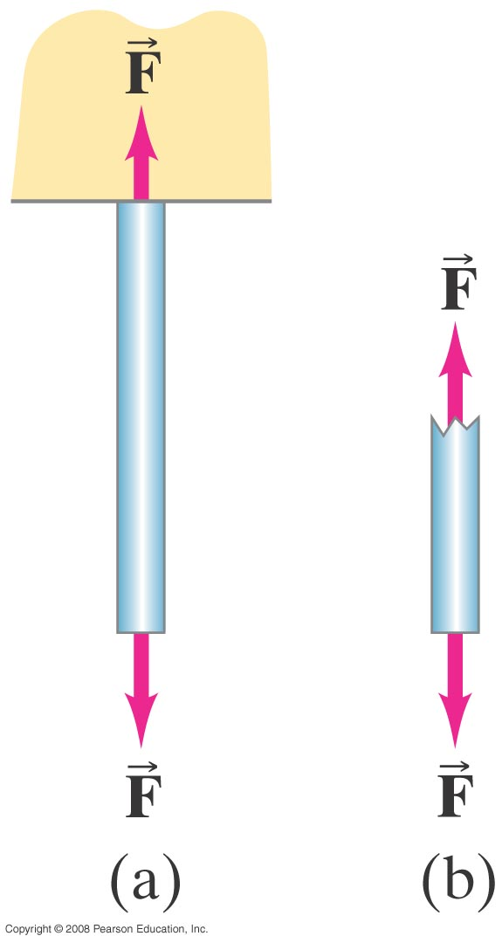
Stress and Strain
The amount the length of an object changes (strain) depends on the applied force (stress). If the stress is not to great, the strain is proportional to the stress:
Behaves like a spring in elastic region

Slide 32
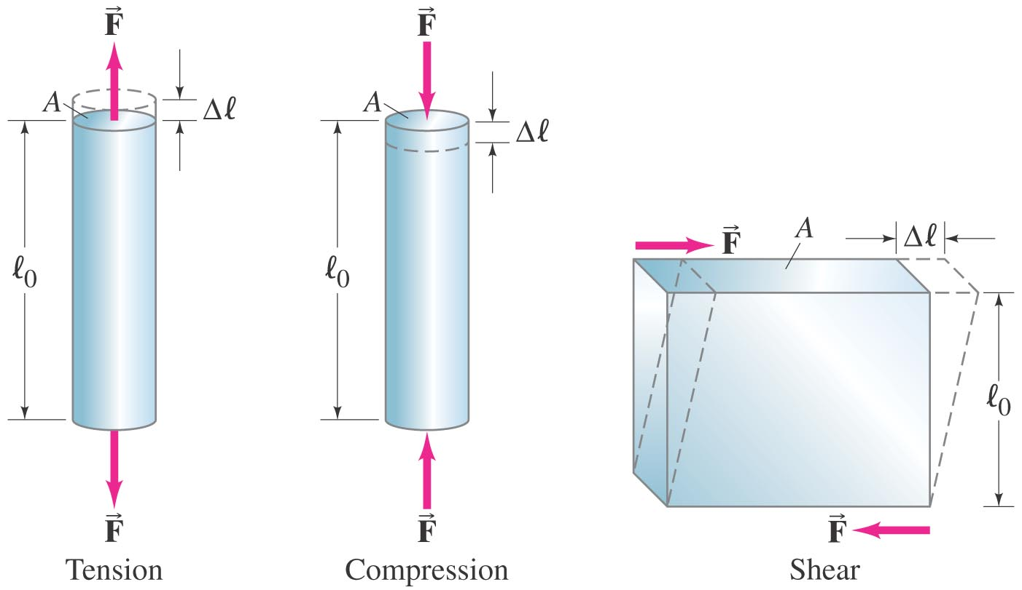
Three Types of Stresses

Slide 33
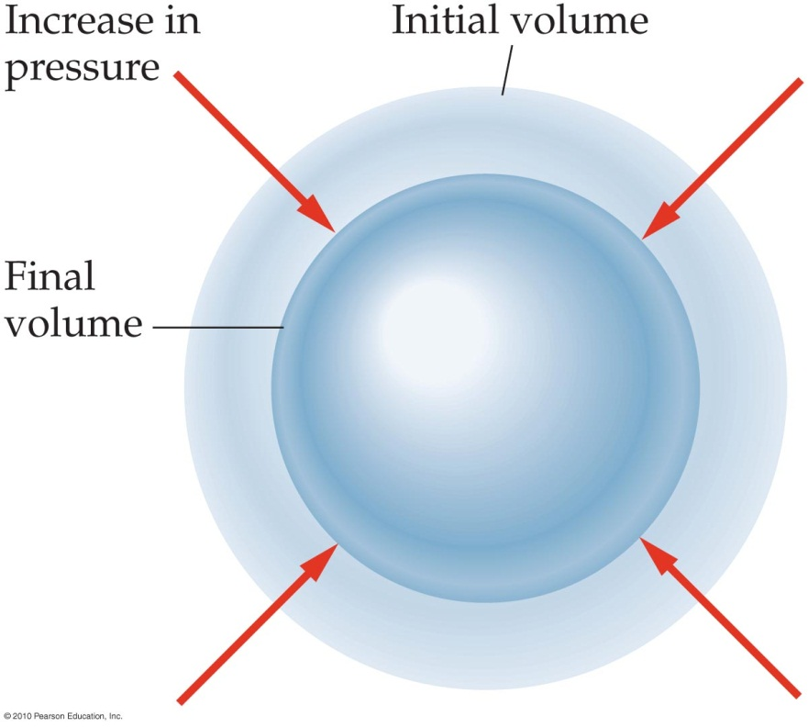
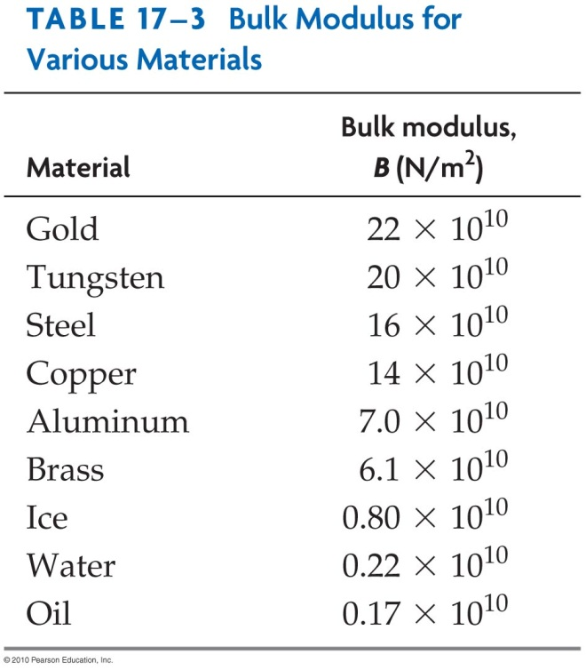
Volume Change: Bulk Modulus
One can have the entire volume of an object change if compressive forces are applied on all surfaces. For example, if we immerse a solid in a liquid then changing the pressure changes the volume.
The constant B is the bulk modulus, which has units of force per area and which depends on the nature of the material.

Slide 34
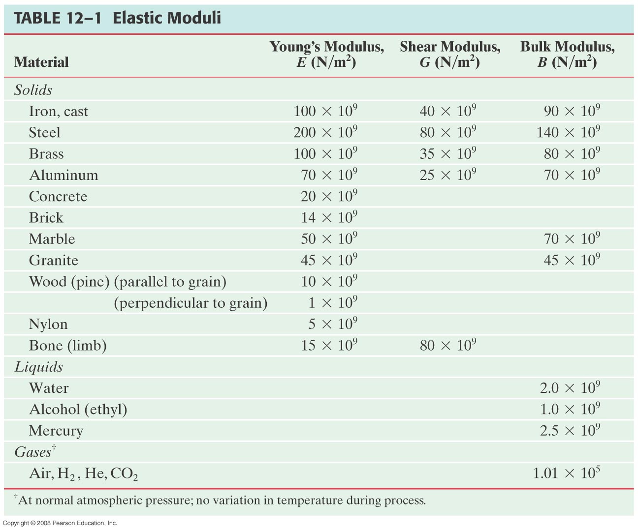
Elastic Moduli

Slide 35
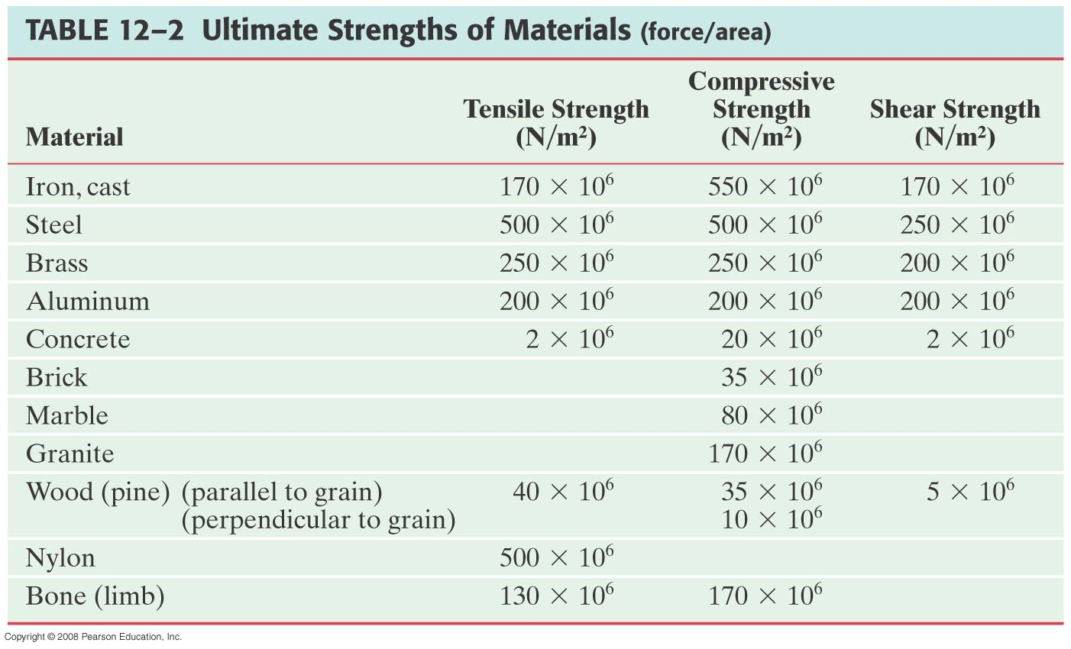
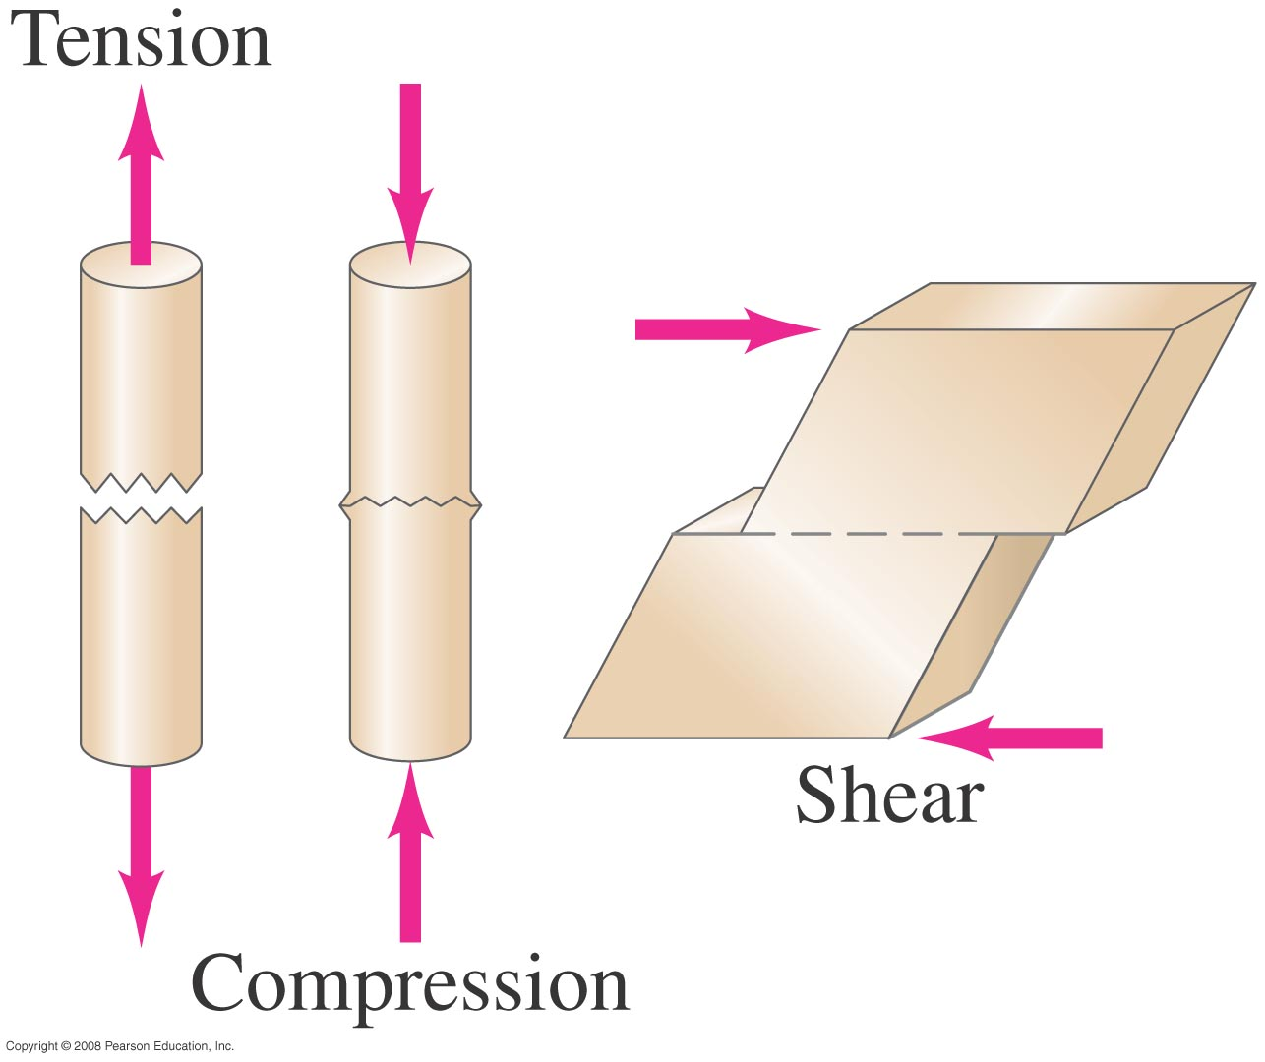
Fracture
Ultimately, materials fail if under too much strain. Engineers need to be aware of safety factors, which depend on the type of structure.

Slide 36

Hyatt Regency Walkway Collapse

Slide 37
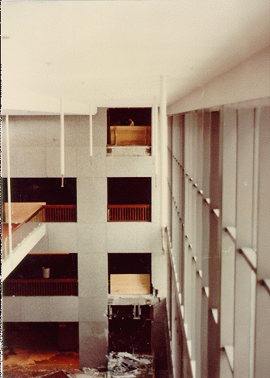
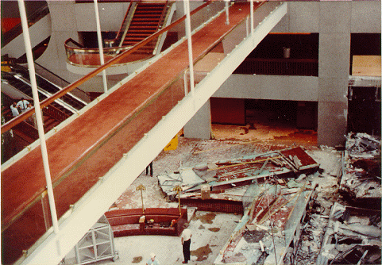
Hyatt Regency Walkway Collapse
On the evening of July 17, 1981 about 1600 people were gathered in the atrium of the newly constructed Hyatt Regency in Kansas City for a dance competition. Suddenly two walkways above the atrium with some 60 people on them collapsed, and 114 people died. Until the collapse of the World Trade Center in 2001 this was the deadliest structural failure in U.S. history.

Slide 38
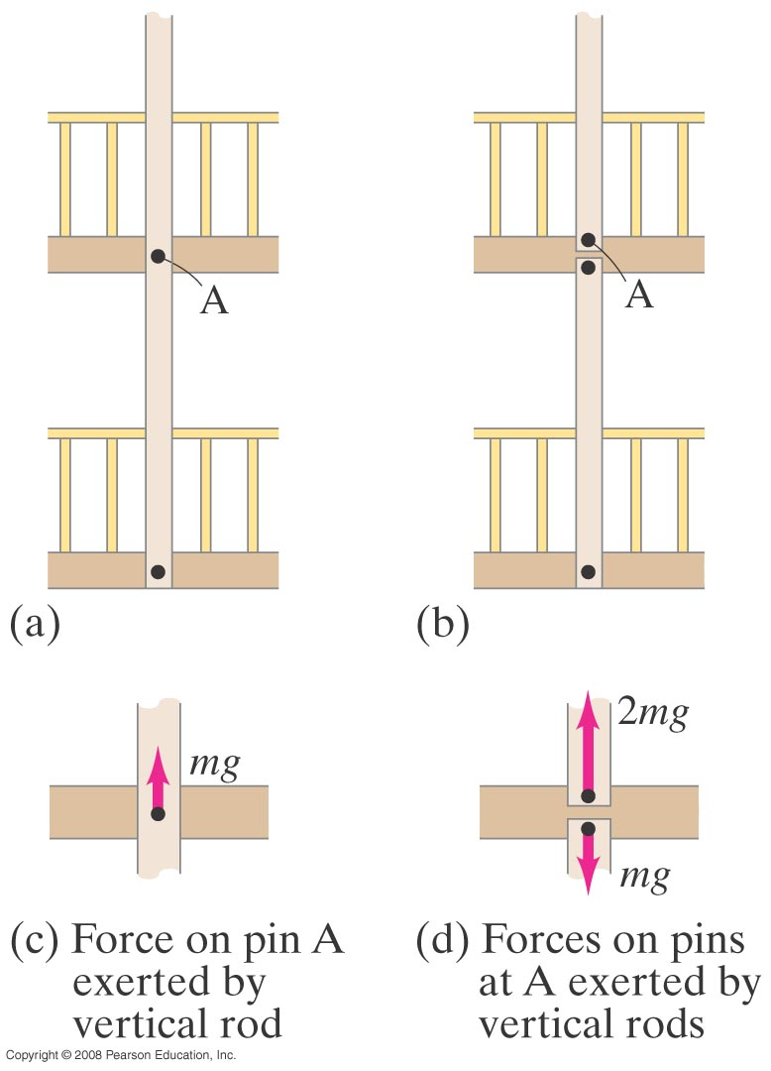
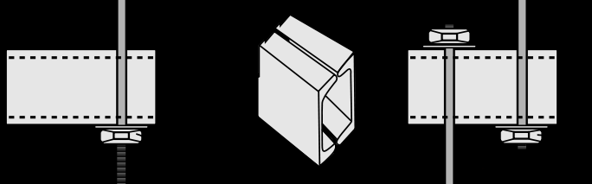
Hyatt Regency Walkway Collapse
What happened? The two walkways were hung by 1.25-in-diameter steel tie rods, with the lower walkway directly under the upper walkway.
The original design was sound, but was modified by the contractor (who knew little physics) in order to simplify construction. That modification put twice the stress on the bolts holding the upper walkway.

Slide 39
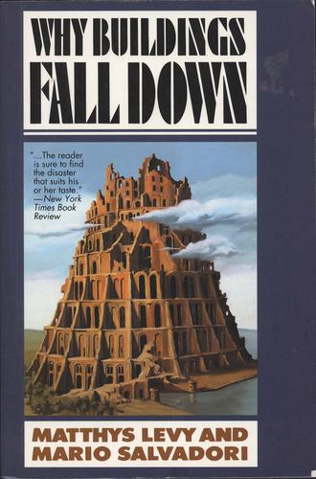

A Couple of Good Books on Engineering Disasters

Slide 40
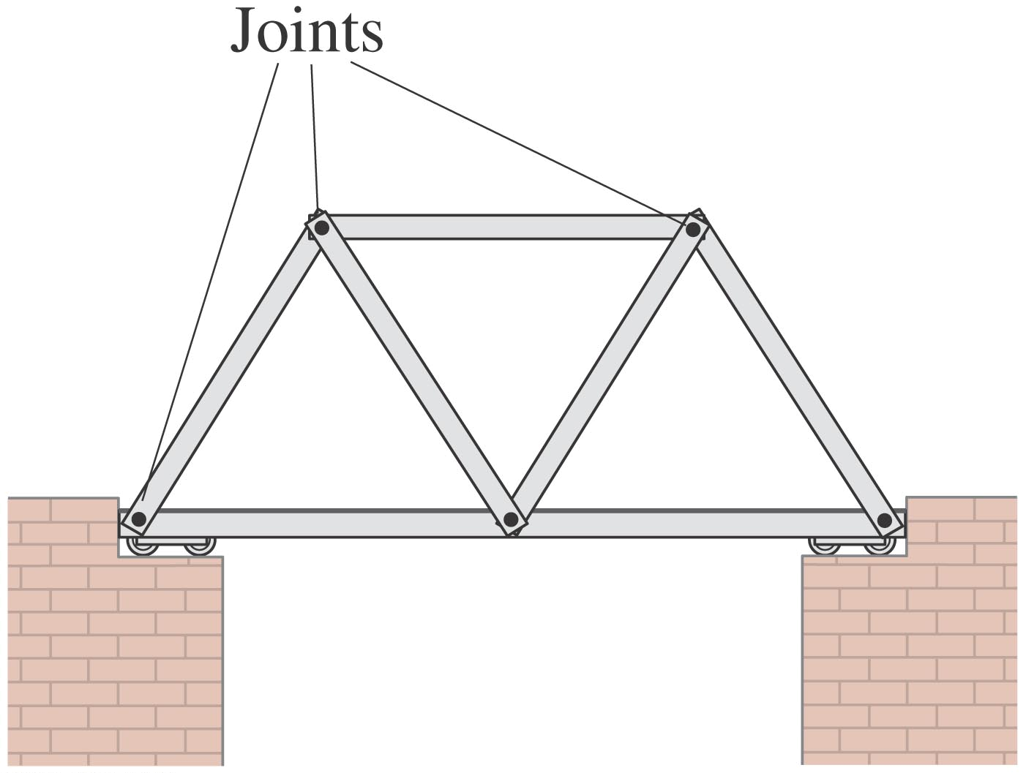
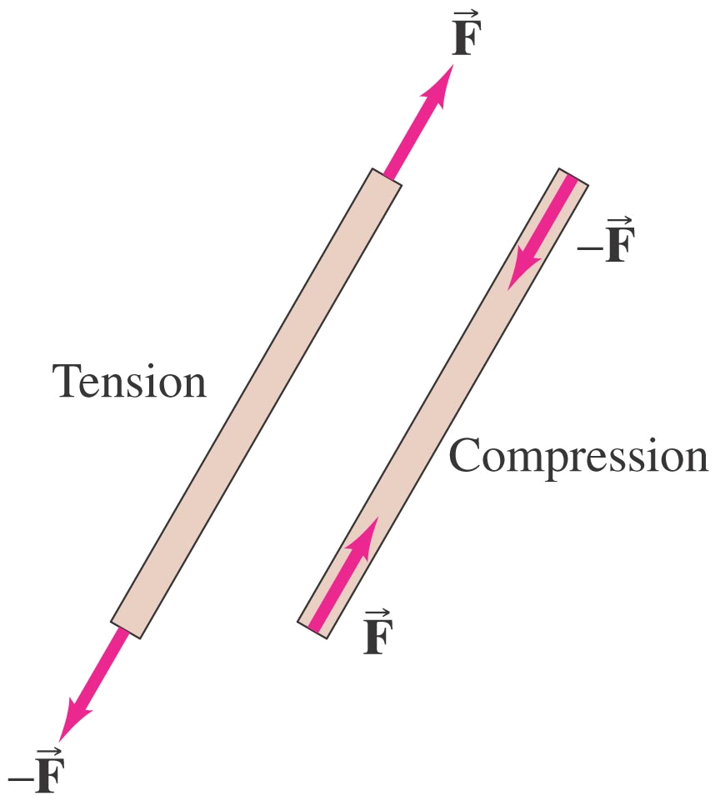
Trusses and Bridges
No motion: static equilibrium. Struts are either in compression or tension.
You are not responsible for this section!

Slide 41
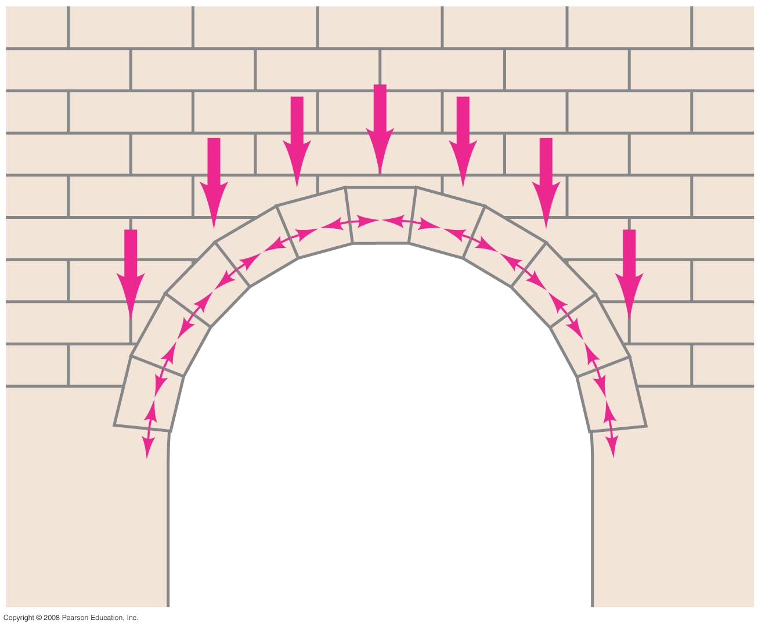
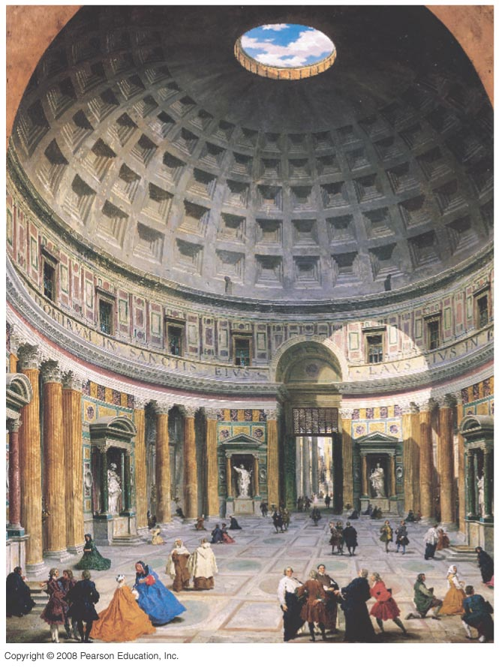
Arches and Domes
You are not responsible for this section!

